Slide 1
Fauvist Inspired Animal Portrait

Slide 2
Fauvism
“Les Fauves, the Wild Beasts, was the name an art critic spontaneously gave to a group of young painters after seeing their works hanging together at the Paris Salon d’ Automne of 1905. The image that leapt to mind of untamed animals shows how aggressive these paintings appeared at first sight to an audience which was only just coming to terms with Impressionism.

Slide 3
Fauvism
Shortly before that historic exhibition, critics had already begun to take notice of Henri Matisse and his fellow students from Gustave Moreau’s class a the Ecole des Beaux Arts: Henri Manguin, Albert Marquet and Charles Camoin, one of the three closely knit groups of painters who constituted the Fauves.”- Sarah Whitefield.

Slide 4
Characteristics of Fauvism
Vivid, Exaggerated Colors
Repetitive Brush Strokes
Rough, Unfinished Look

Slide 5
Some of the Most Famous Fauves:
André Derain
Henri Matisse
Henri Manguin
Albert Marquet
Charles Camoin
Maurice Vlaminck
Jean Puy
Gustave Moreau

Slide 6
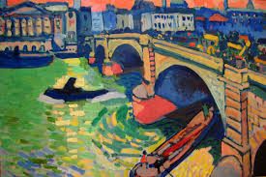
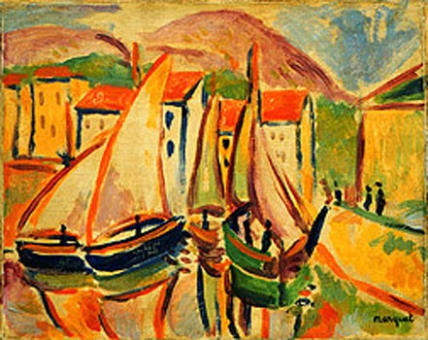
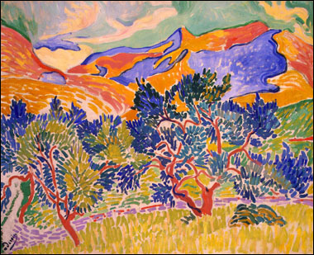
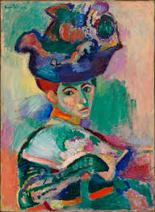
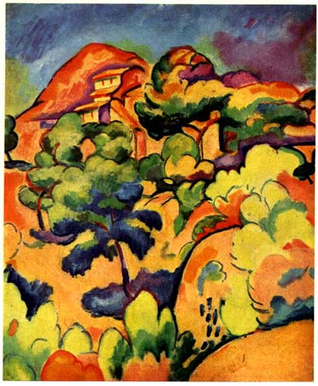
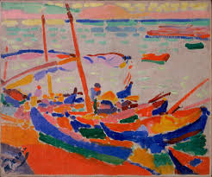
Famous Fauvist Works…..(there are so many beautiful Fauvist works….. research!)

Slide 7
Objective
You will create a portrait of an animal inspired by the work of the Fauves.

Slide 8
Requirements:
Your work will be bold in color and exaggerated where effective.
No small portraits! You need to work large and can crop the animal, if you wish.
You must use oil pastel on white or black paper for the highest contrast .
You will need to do some research on your own as well. I want 1 page dedicated to Fauvism in your journal. You need to label the page Fauvism (creatively) and include the definition. Design it any way you wish in the spirit of Fauvism. This will be due at the time you turn in your project.

Slide 9
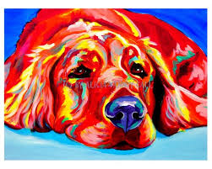

Slide 10
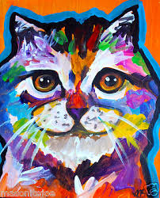

Slide 11
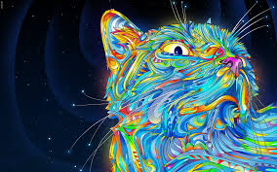

Slide 12
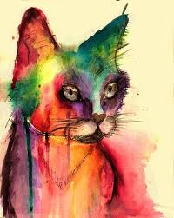

Slide 13
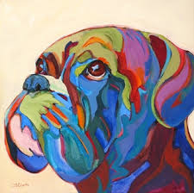

Slide 15
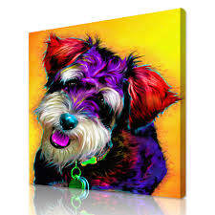

Slide 16
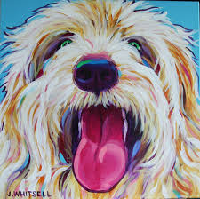

Slide 17
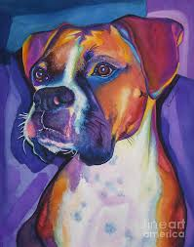

Slide 18
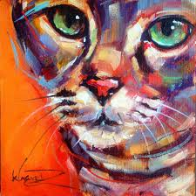

Slide 19
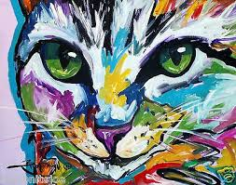

Slide 20
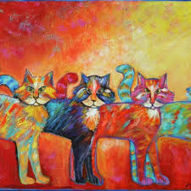

Slide 21
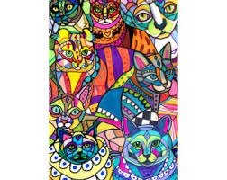

Slide 22
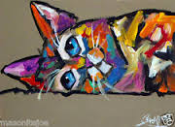

Slide 23
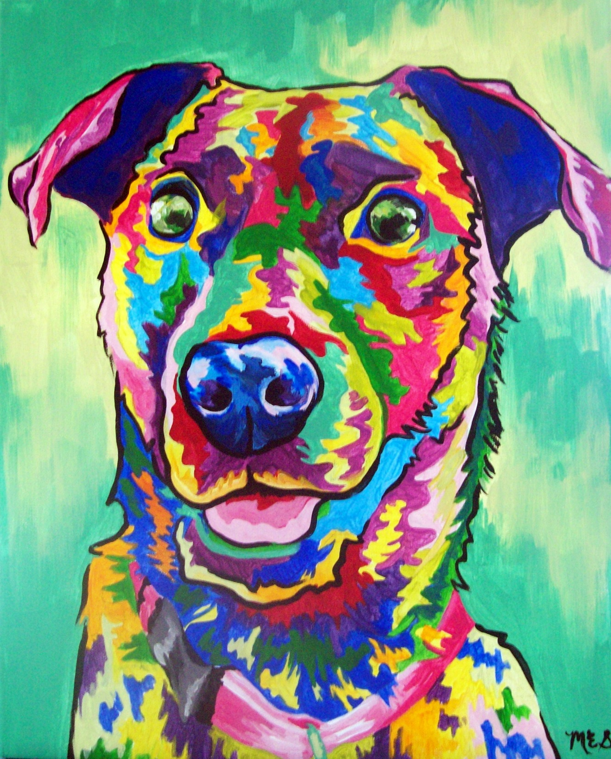

Slide 24
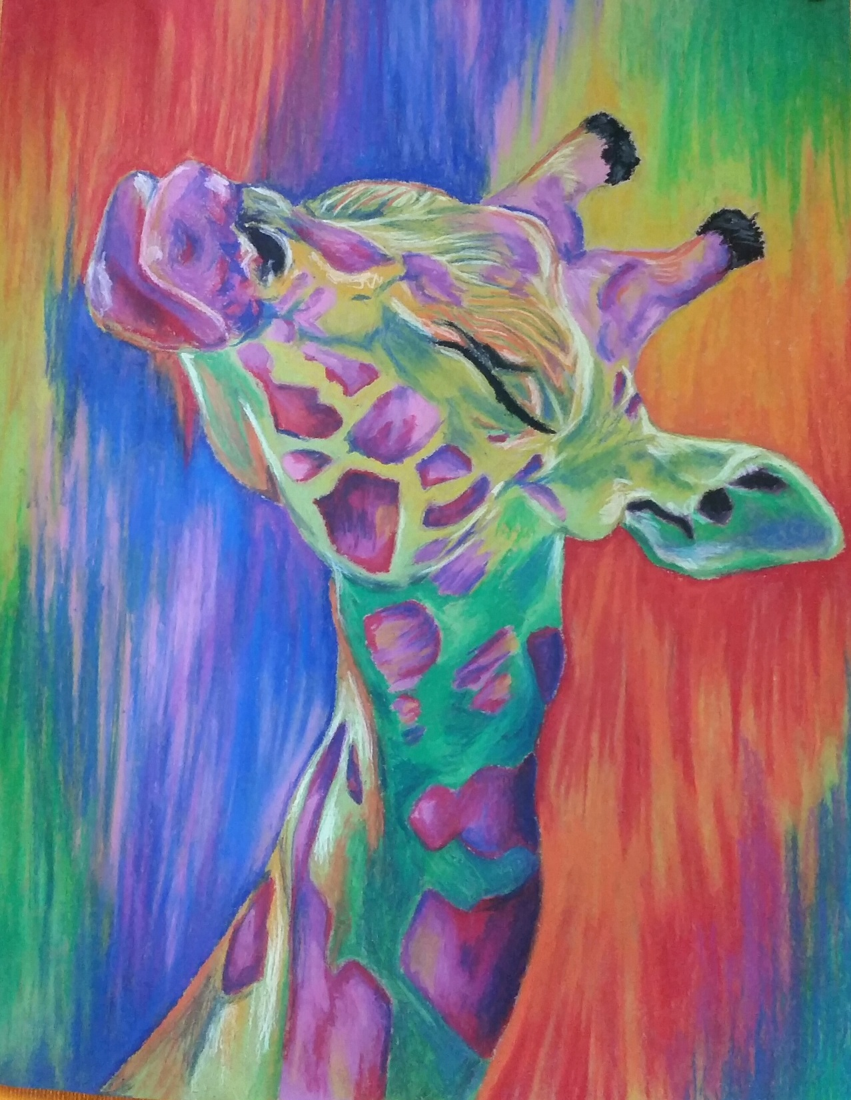

Slide 25
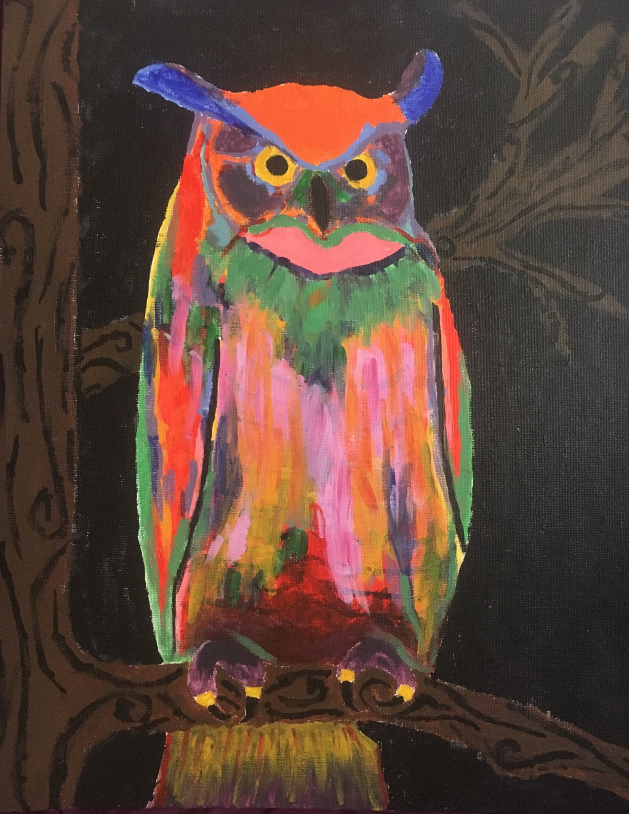

Slide 26
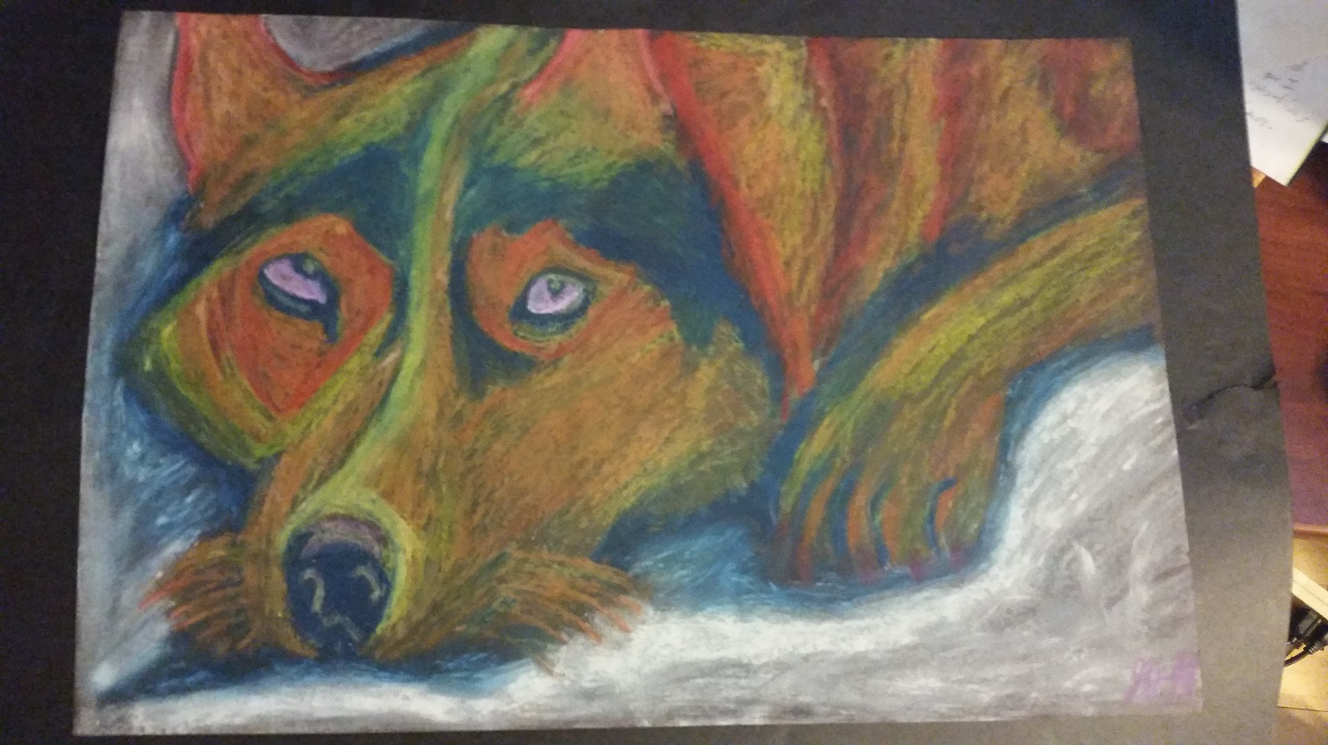

Slide 27
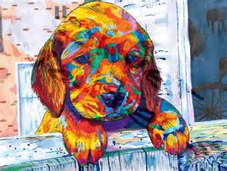

Slide 28
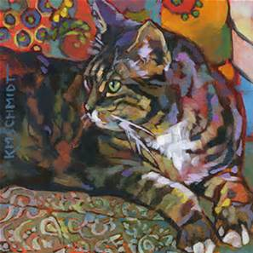

Slide 29
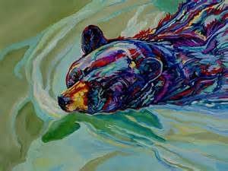

Slide 30
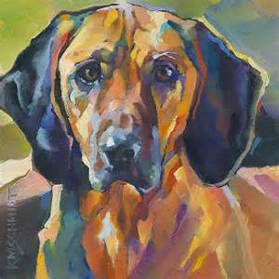

Slide 31
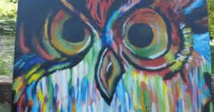

Slide 32
